Slide 1



Python Tsunami
– April 21st-23rd –

Slide 2
What else?
Your own packages: Classes
Scikit-learn: Machine Learning in Python
Community: NNF Computational Biology Network

Slide 3
The Car Problem
Describe this object:
Parts: wheels, a stirring wheel, a frame, etc.
Actions: moves, breaks, etc.
Describe a car
Problem
subproblem
subproblem
subproblem

Slide 4

The Car Problem
Describe this object → Class:
Parts: wheels, a stirring wheel, a frame, etc. → variables or attributes
Actions: start, change gear, etc. → functions
Describe a car
Problem
Variables:
color = “blue”
number_of_wheels = 4
motor = True
power = “gas”
gear = None
Functions:
def start_engine():
. . .
def change_gear(gear):
. . .
subproblem
subproblem
subproblem

Slide 5

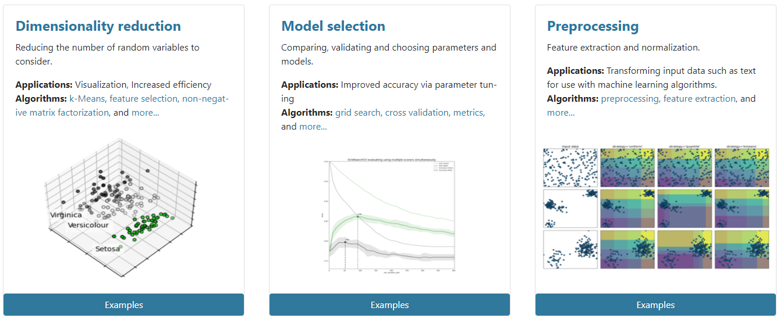
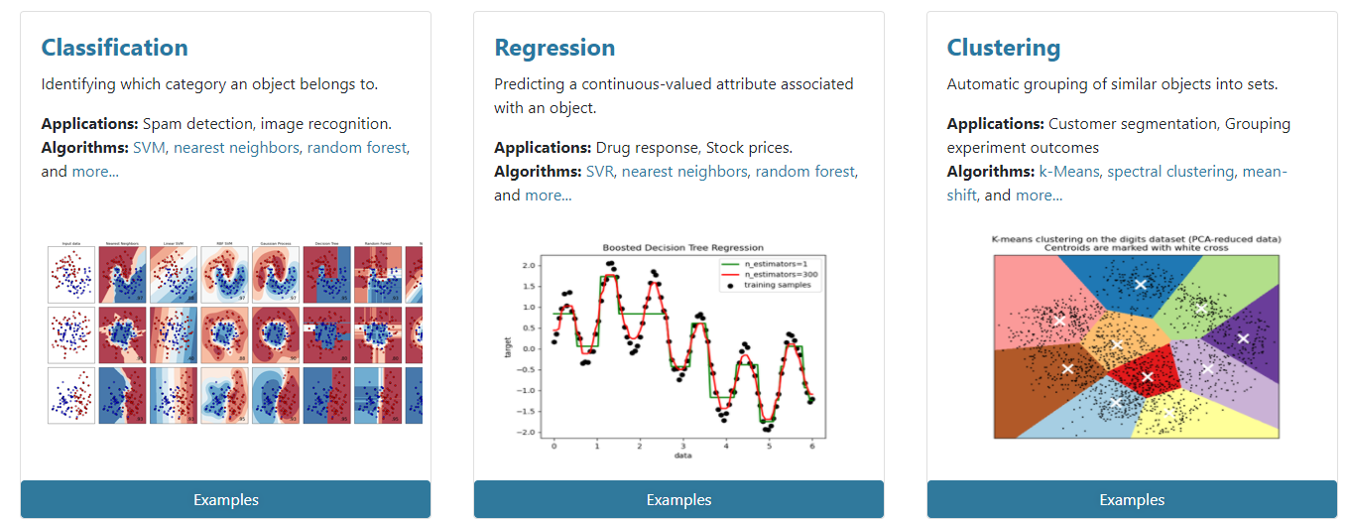
Machine Learning in Python

Slide 6


Community
Slack NNF Computational Biology Network:
https://join.slack.com/t/nnfcbn/shared_invite/zt-piuxr1es-e08yRLg4iGNZTIBfjoPEjg
HeaDS: Center for Health Data Science
Building 33.4 in Panum – pass by, write, anything…

Slide 7


The Team
Alberto Santos (HeaDS)
Annelaura Bach Nielsen (NNF CPR)
Davide Placido (NNF CPR)
Henry Webel (NNF CPR)
Marilena Hohmann (HeaDS)
Philip Charles (DBI (Oxford, UK))
‪Rita Colaço (PRI)
Roc Reguant (NNF CPR)
Thilde Terkelsen (HeaDS)

Slide 8
Other Members of the Team
Dhouha Grissa (NNF CPR)
Grzegorz Jerzy Maciag (BRIC)
Jose Alejandro Romero Herrera (HeaDS)
Katerina Nastou (NNF CPR)
Kübra Altinel (BRIC)
Marta Matos (GENOME Center)
Nicholas Luke Cowie (DTU)

Slide 9
Thank You!

